Slide 1


Irevolution: A Data-driven Exploration of Apple's iPhone Impact in India
TEAM ID: NM2023TMID15887
III B. sc MATHEMATICS E/M
KALAINGAR KARUNANIDHI GOVERNMENT ARTS COLLEGE FOR WOMEN (A),PUDUKKOTTAI - 622001

Slide 2
TEAM MEMBERS
TEAM LEADER:
R.Pavithra- bdu1621ME1226
TEAM MATES :
K.R.Ponnammal- bdu1621ME1227
S.Priyadharshini - bdu1621ME1228
G.Priyadharshini– bdu1621ME1229

Slide 3
INTRODUCTION
The global landscape has undergone significant transformations with the widespread adoption of smartphones, fostering enhanced communication, connectivity, and a paradigm shift in various industries. Apple Inc., a key player in the smartphone market with its flagship product, the iPhone, has secured a substantial presence across international markets. Notably, in India, a rapidly growing economy, the surge in smartphone usage has positioned it as a compelling market for studying the repercussions of Apple's iPhone.

Slide 4
VISUALIZATIONS
A given dataset possesses the potential for a diverse array of distinctive visual representations. Various common visualization types, such as bar charts, line charts, heat maps, scatter plots, pie charts, maps, among others, are valuable tools for scrutinizing the performance and efficiency of a project. These visual tools serve multiple purposes, including performance comparison, temporal change tracking, and illustrating the distribution and relationships between different variables within the dataset

Slide 5
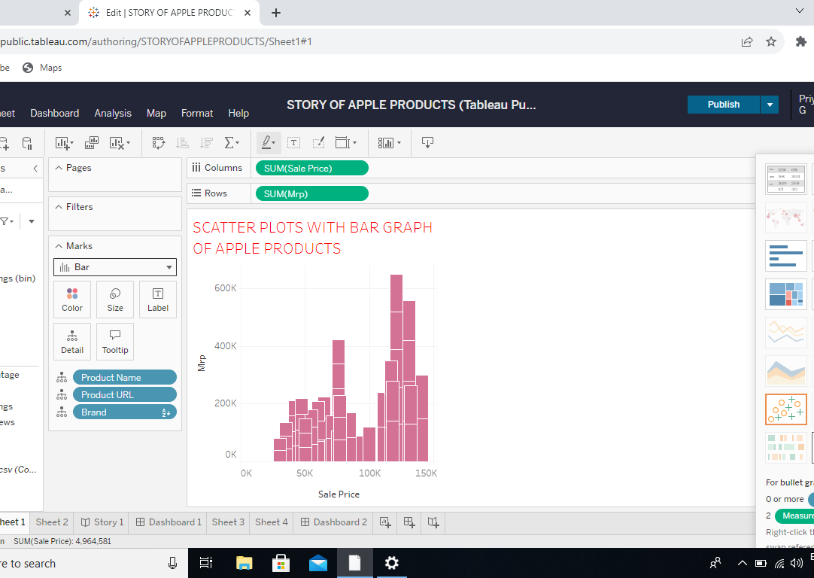
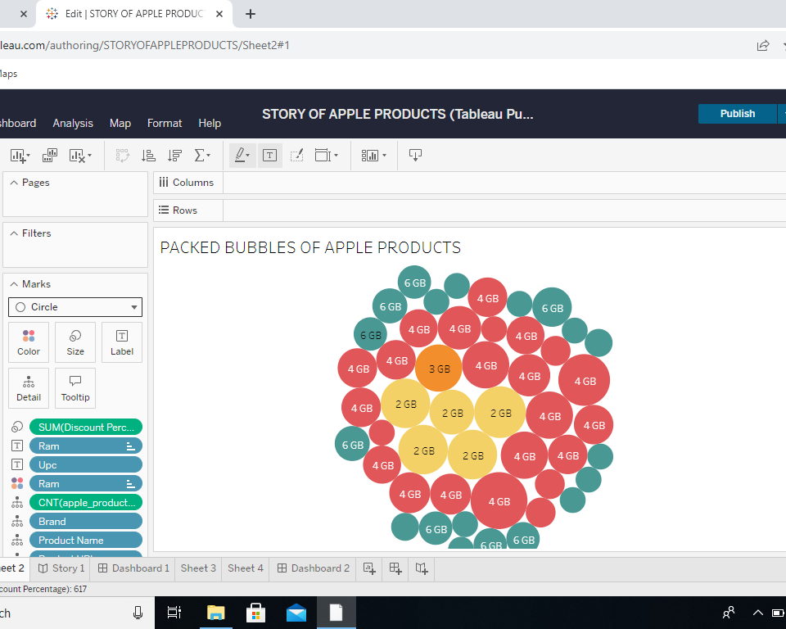
Sale Price & Mrp
Ram & Upc

Slide 6
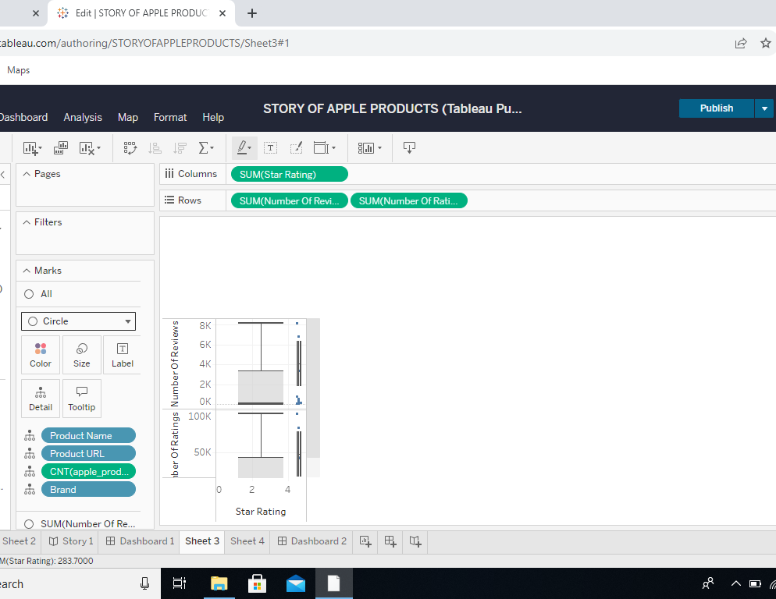
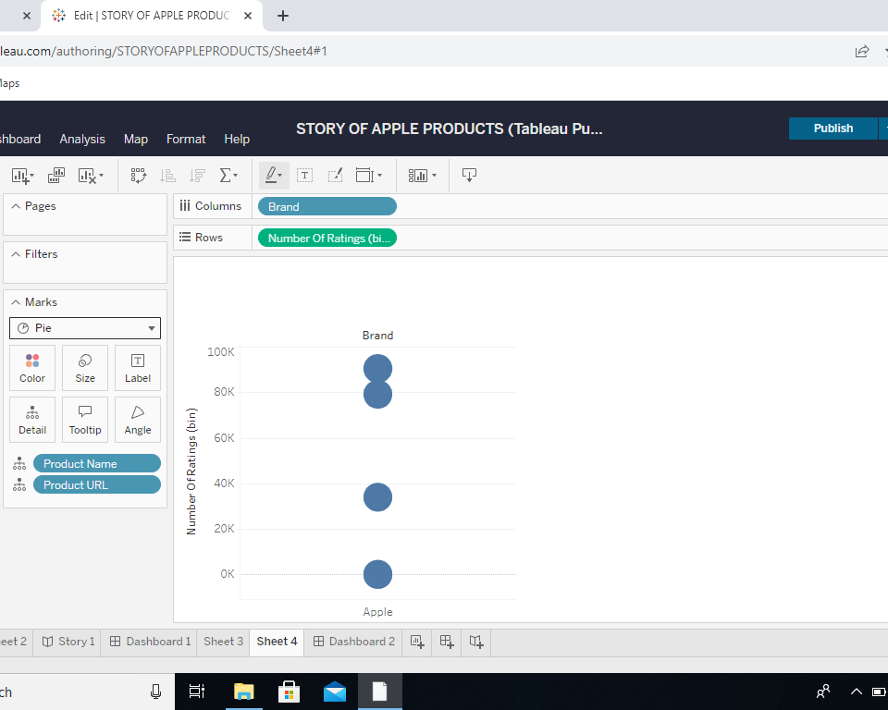
Number of Ratings & Number of Reviews
Number of Ratings (bin)

Slide 7
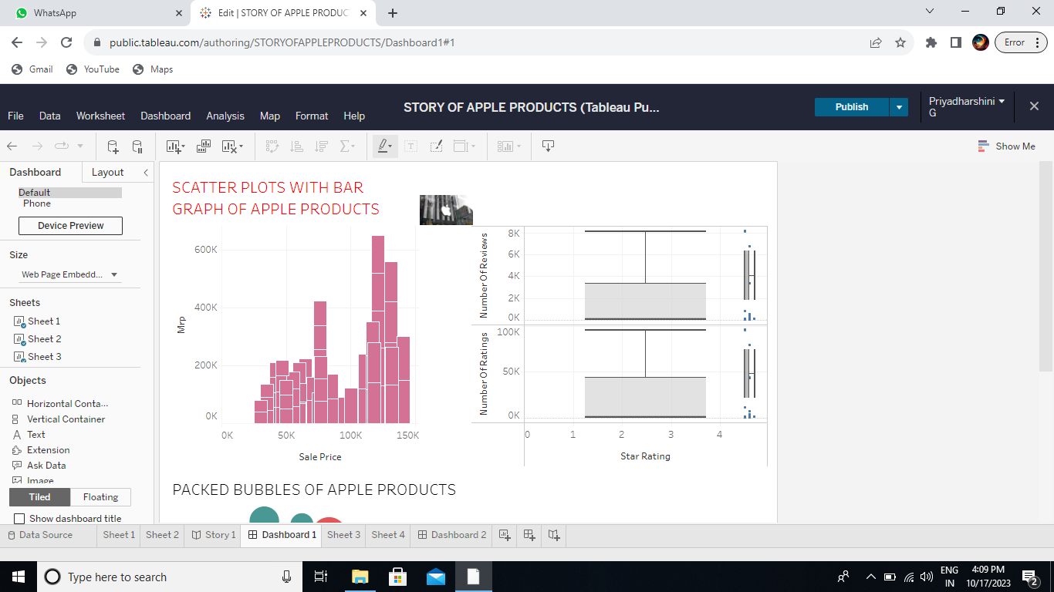
Dashboard 1

Slide 8
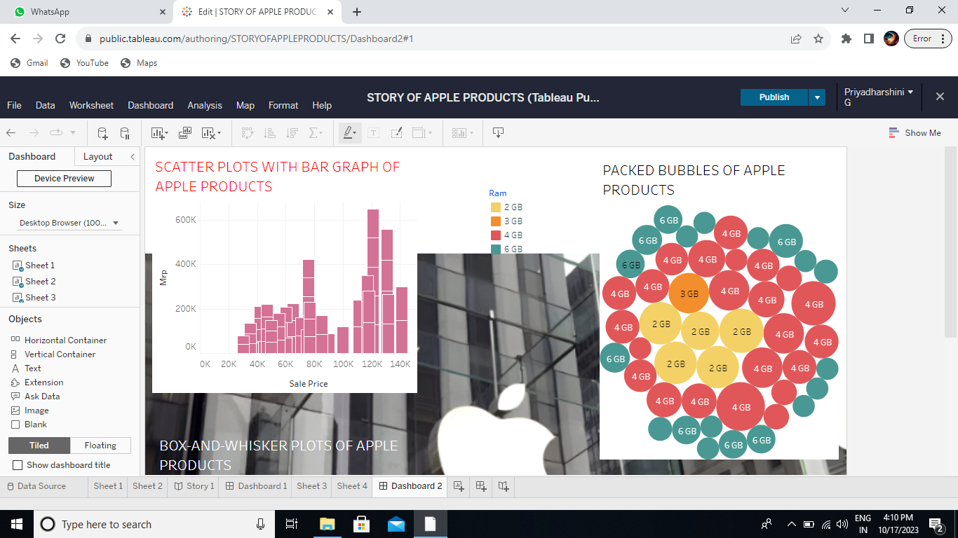
Dashboard 2

Slide 9
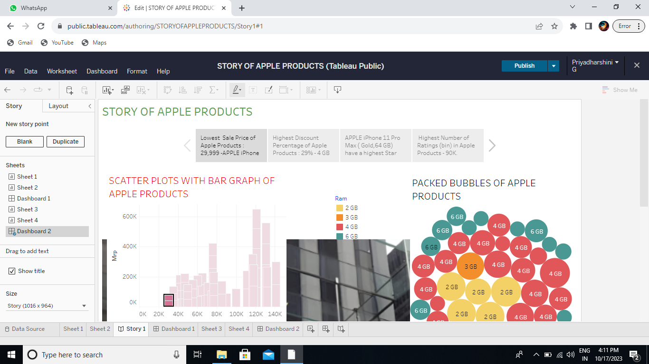
Story Board

Slide 10
Conclusion
The “Irevolution" project, through its data-driven exploration, provides a nuanced understanding of the impact of Apple's iPhone in India. The findings and visualizations generated through Tableau offer actionable insights for Apple's strategic decision-making, marketing endeavors, and potential collaborations in the dynamic Indian market. This project exemplifies the transformative potential of data analytics in unraveling the multifaceted impacts of technology on societies and economies

Slide 11
Future Scope
“Irevolution" offers valuable advantages while necessitating thoughtful consideration of potential challenges. Its future scope indicates opportunities for more advanced and comprehensive research, ensuring Apple's continued relevance and success in the Indian market

Slide 12


